Slide 1
Rapid Genome Sequencing – Pediatric(?) Applications of Sequencing Technologies
Bimal P. Chaudhari
CSHL 2025

Slide 2
Disclosures
Biomarin
I'm a patient-facing clinician
I’m probably the dumbest person in the room

Slide 3
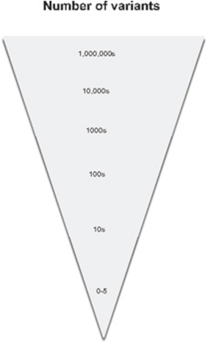
Variant Filtration
Genotype quality
Read depth
Inheritance
Type of variant
Allele frequency (remove common variants)
Biomedical plausibility
Advances in Molecular Pathology 2018 1, 9-26DOI: (10.1016/j.yamp.2018.06.003)
Notes:
Depending on the application, variants are filtered using a variety of rules with the goal of achieving a list of candidates short enough for detailed human review.

Slide 4
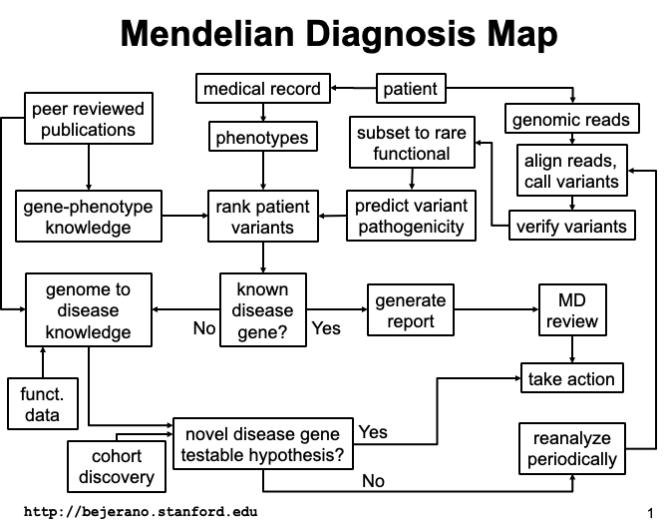
Bytes to Bedside

Slide 5
Genomics at the bedside
Notes:
On that sobering note, let’s switch gears and talk about the implications of this technology at the bedside. Is pediatric genomic medicine any good?

Slide 6
Hope or Hype?
“In coming years, doctors increasingly will be able to cure diseases like Alzheimer’s, Parkinson’s, diabetes, and cancer by attacking their genetic roots. It is now conceivable that our children’s children will know the term cancer only as a constellation of stars.”
-Francis S. Collins, in 2000
Notes:
20 years on, this sounds pretty naïve and Dr. Collins get a lot of flack in the popular press for this statement whenever folks want to argue that we spend too much on genomics at the NIH.

Slide 7
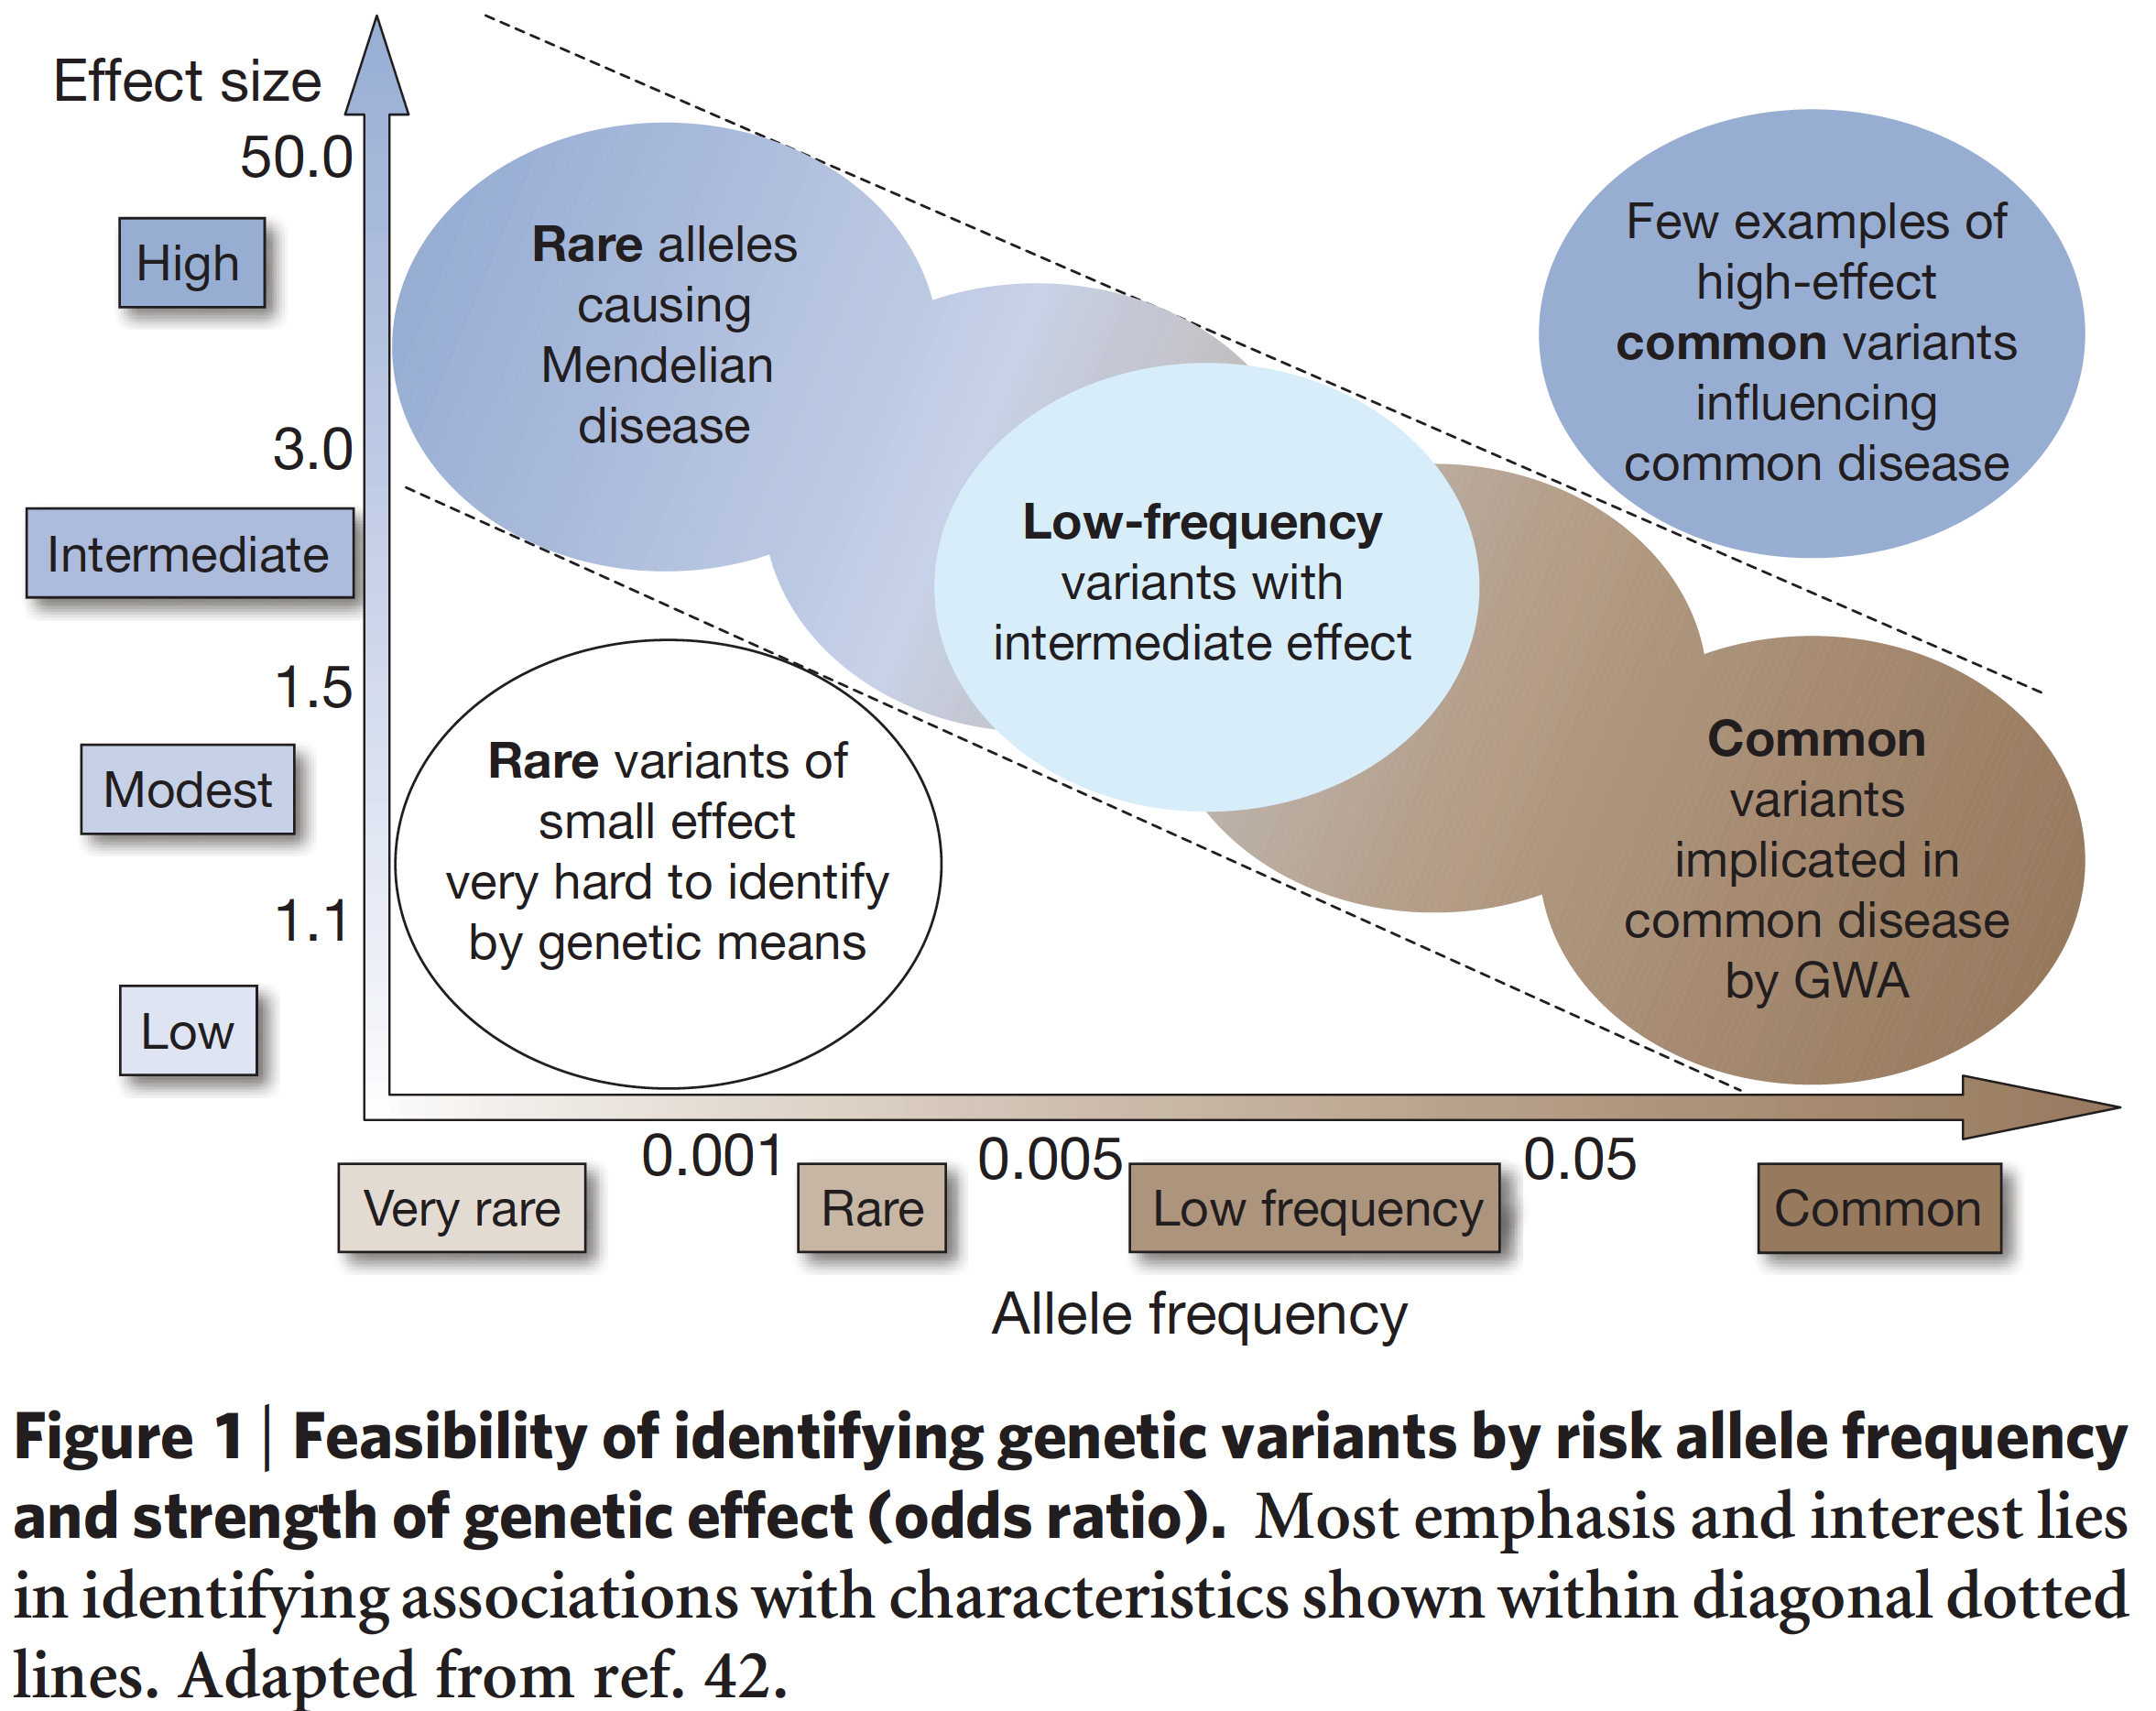
Rare Variant + High Effect Size
23 & Me
Ancestry
Notes:
In practice, though, we’re not really looking at the whole genome. What we care about is rare genomic variation with high effect size causing rare genetic disease.
In this figure we can see the frequency of genomic variants across the horizontal axis and the effect size on the vertical axis.
Those of you not active in this area may be more familiar with consumer genomics companies like 23 & Me or Ancestry.com *CLICK* who make inferences about ancestry or common disease susceptibility based on common genomic variation of modest effect size. *CLICK*
Neonatal Genomic Medicine is NOT about that *CLICK* We’re looking for rare or very rare variants of high effect size *CLICK*

Slide 8
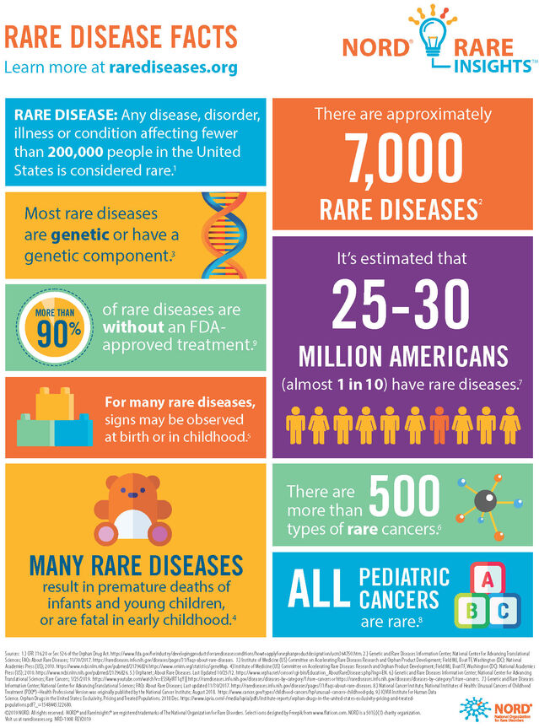
<200,000 Americans each
Most are genetic
Many present to Level IV NICU
There are ~7000 RD
1 in 10 Americans has a RD
Notes:
I've used the term 'rare disease' a few times. Let's unwrap that term. Because it turns out rare diseases are NOT rare!

Slide 9
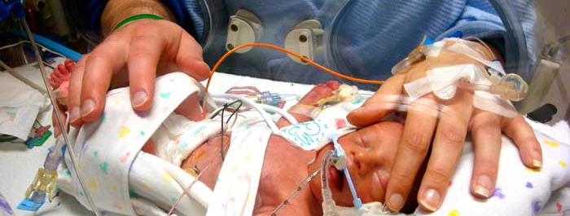
Where Minutes Matter

Slide 10
Rare is Common
~50% of children <4mo in a combined quaternary NICU/PICU/CVICU population are without an obvious non-genetic cause
Of those, 30% diagnosed by GS
Diagnostic odyssey ~4.8y
Gonzaludo, et. al. GiM 2018, Petrikin et. al. Gen Med and Engle et. al J Rare Dis
Notes:
Despite how common rare diseases are, children with these conditions continue to face multiyear diagnostic odysseys due in large part to a lack of recognition of a potentially diagnosable condition as well as failure to use broad genomic diagnostic tools early in the process.

Slide 11
Population | Diagnostic Yield | Management Change/Comment
ICU | 20-60% | 20-30%
GDD/ID | 10-40% | 5%
Suicide/refractory depression | 21/33 | Likely selection bias
Primary immunodeficiency | 15-60% | 34%
CHD | 10-60% | Isolated vs syndromic
Early onset Epilepsy (<5yo) | 33-45% | 39%
Short Stature w/o endocrinopathy | 33% | 16%
CAKUT | 20% | 10-15%
Neonatal Cholestasis | 60% | Excluding BA & TPN
Notes:
These are of course not the only two conditions where genomic testing may be underutilized. Here I pull data from several different studies of populations and settings where genomic approaches to testing lead to significant diagnostic yield and inform management. Where the data were more limited, I provide the actual numerator and denominator.
I would venture to say that there are very few, if any, subspecialties where one could not define a subset of patients whose care would likely be informed by early genomic diagnosis

Slide 12
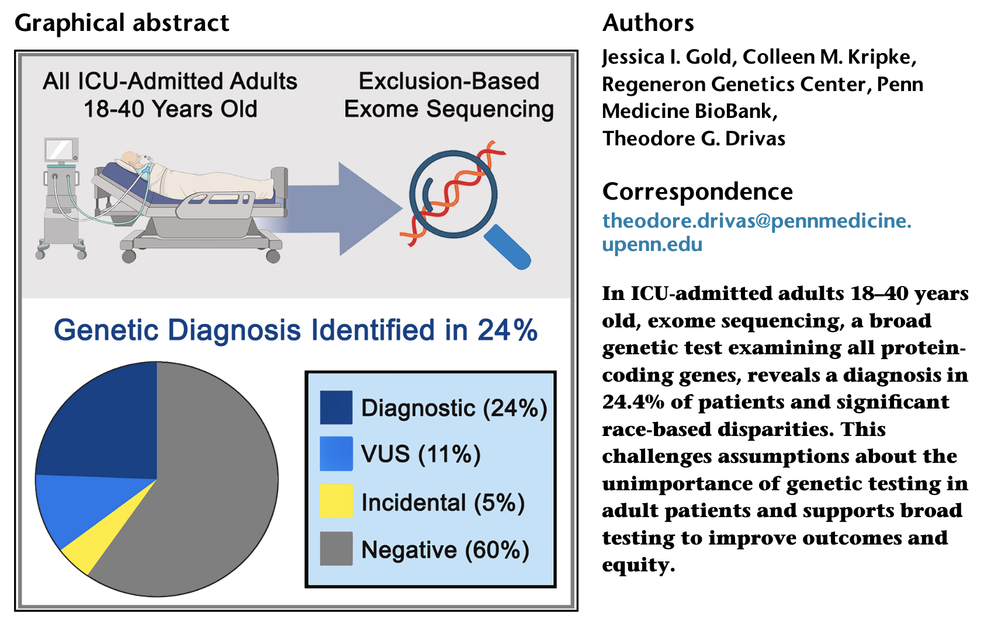

Slide 13
Scale & Efficiency
300k births/year require intervention
30k+ require ongoing NICU care
300k PICU admissions/year
60k without an obvious non-genetic reason
rGS cost effective before ICU day 14

Slide 14
Scaling Needs
Sequence quickly
Automate knowledge linkage
Need to surface potentially diagnostic variation and treatment implications ASAP

Slide 15
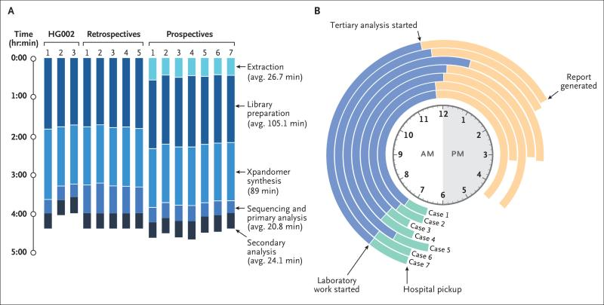
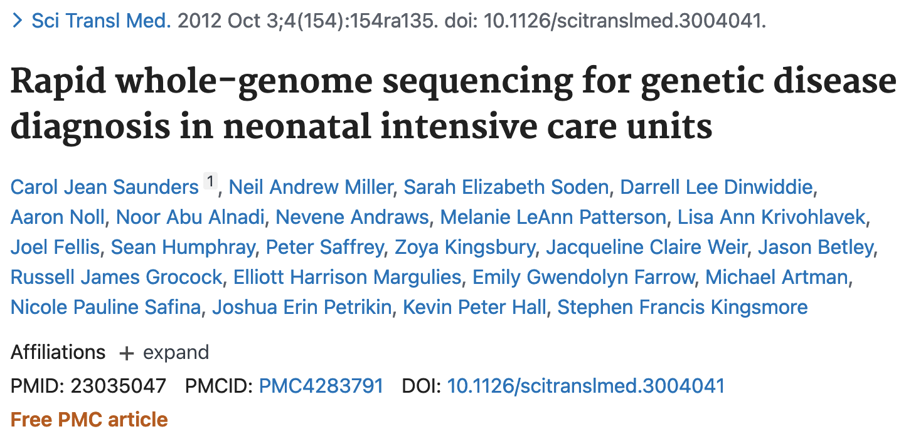
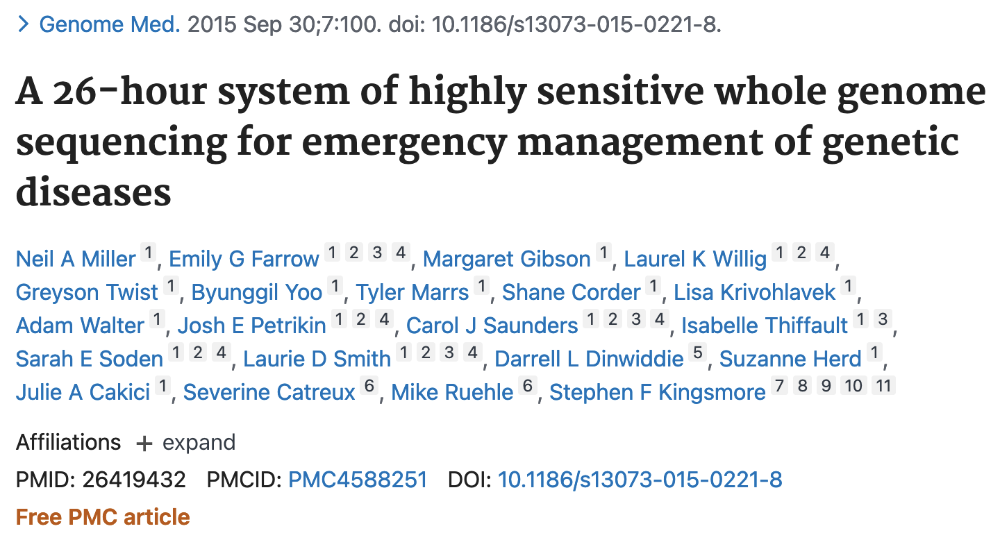
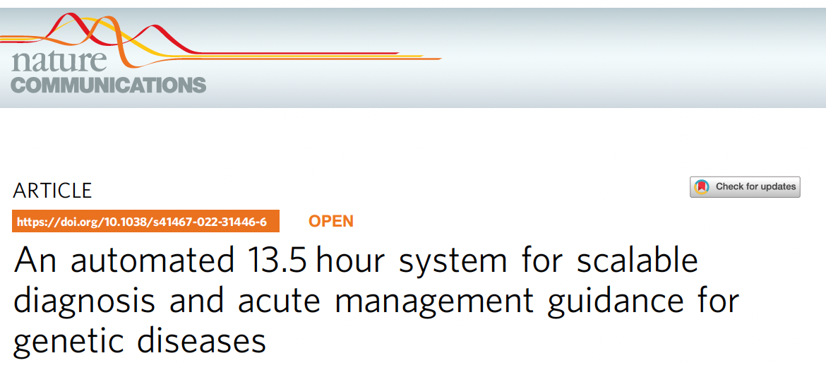
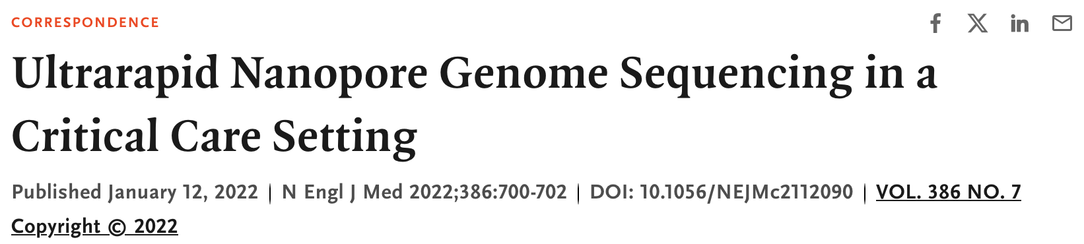
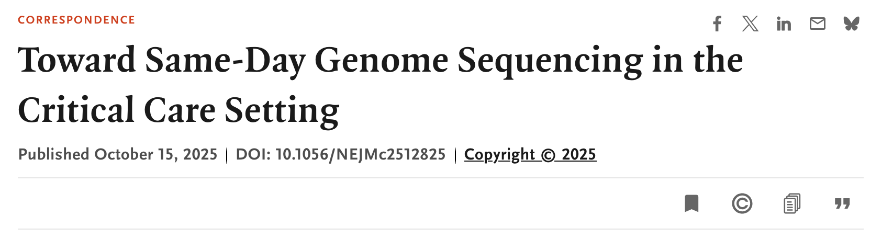
Sequencer Go Fast

Slide 16
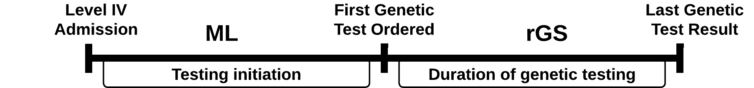
Doctor Go Slow
At best 50% of testing STARTS by ICU day 7
25%-50% of patients in Level IV NICU don’t get first test until AFTER discharge!
Notes:
If we ultimately want to use ML to drive genetic testing practices, it is important to understand where it can actually be helpful.
TWO things determine the length of your diagnostic Odyssey:
WHEN you start testing (which ML can most directly impact via clinical decision support)
WHAT testing strategy you use (ie the historic step-wise testing strategy of an array and/or panel before obtaining a genome vs. Skipping straight to rapid geneome sequencing as multiple clinical trials have demonstrated to be a superior strategy)
In order to plan a clinical trial using ML to support neonatologists in flagging babies for genetic testing/consultation (ideally with rGS) we simulated running the ML classifier daily through the first week in the ICU using real world data from our validation cohort. Simulated neonates recieved rGS either when the baby was actually tested or when the predicted probability by the ML was >40% (the threshold at F1), whichever came first. If the predicted probability remained <40% through the first week in ICU, testing happened when it happened.

Slide 17
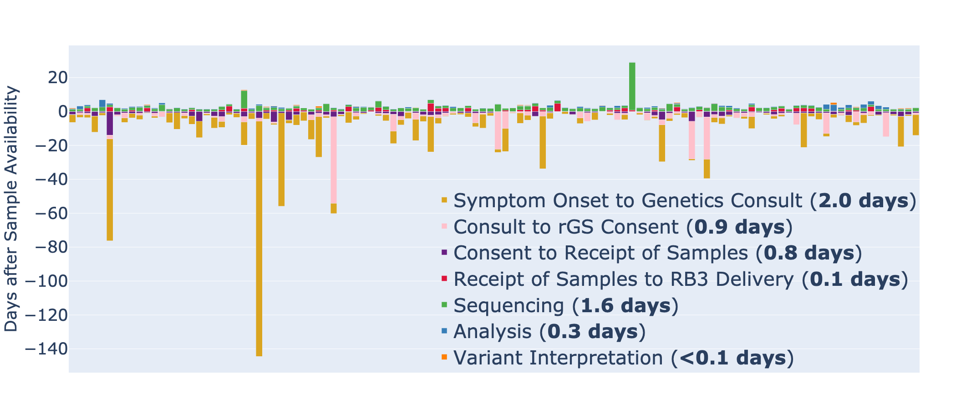
Doctor Go Slow (II)

Slide 18
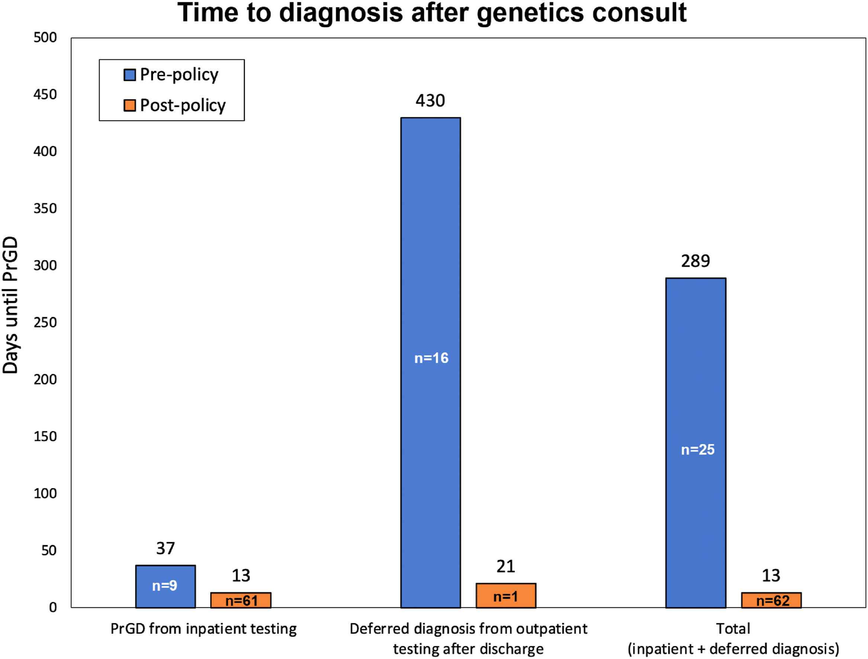

Slide 19
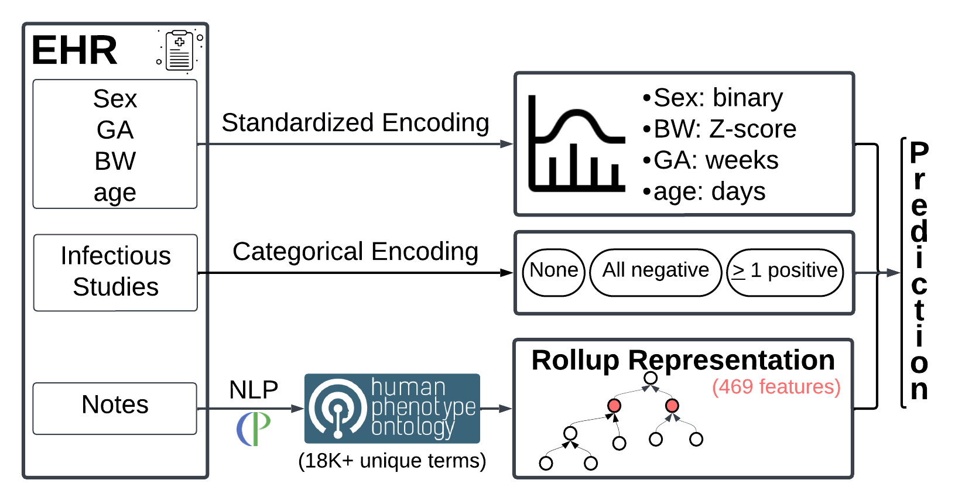
Notes:
So do we make these prediction? We wanted to develop a system that would require no additional input from busy clinicians
Here you see a schematic of how we go from data in EHR to Predictions
We use routine parameters collected at birth, the ordering of and outcome of infectious disease studies and free text clinical notes mapped to the human phenotype ontology, encoded by information content. The precise way in which we collapse the HPO graph to a smaller subset of nodes was a tunable hyper-parameter.

Slide 20
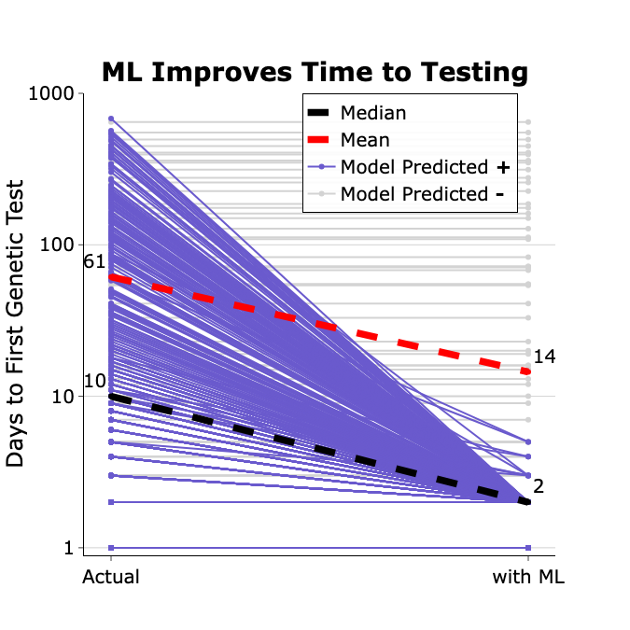
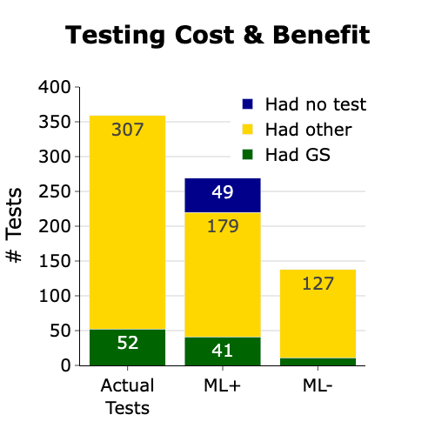
No Free Lunches
Notes:
So what happens?
On the left is a parallel coordinates plot.
the vertical axis of days to testing is log scaled to account for cases with really delayed starts. Every thin line is a subject.
On the left is the true time from admission to testing and on the right is the same time, under our simulation.
In purple, you see every subject flagged by the model and In grey you see the subjects not called as positive by the model.
Median time to testing falls from 10 days to 2 days in our simulation. Because we successfully identify kids who would have gone months or years without testing, the mean time to testing falls from 61 days (2+ months) to 14 days (2 weeks).
On the right, we see the actual number of tests (genome and non-genome) ordered in a year in our simulated NICU, followed by the breakdown based on the ML predictions. Importantly these are tests, not people. They don't precisely add up due to rounding. Under our simulation policy,
there are ~1120 neonates admitted in a year.
In actuality ~216 BABIES get testing at some point, receiving 52 genomes and 307 other genetic tests.
~200 babies are ML+, of which, in actuality, 49 never got any testing based on their real world experience and the remainder received 41 genomes and 179 other genetic tests. Manual chart review reveals ~37% or 18 of the 49 who never got testing were actually plausible candidates for early life genetic testing in ICU.
~920 babies were labeled ML- and, in actuality, they received 10 genomes and 127 other genetic tests

Slide 21
Bytes to Bedside

Slide 22
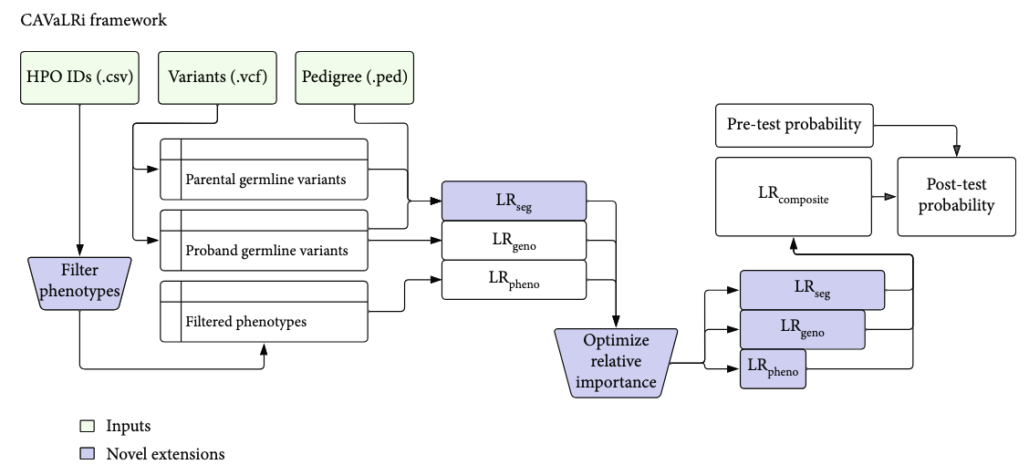
Automating DIAGNOSIS

Slide 23
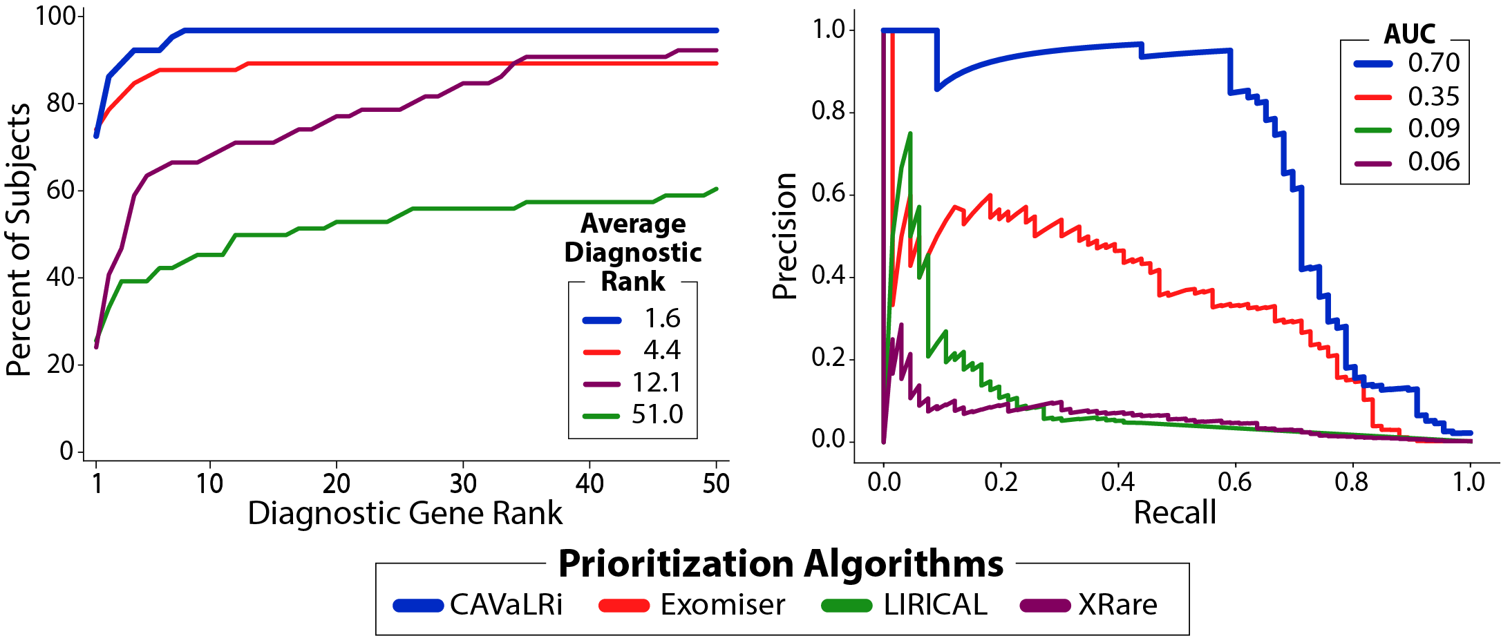
CAVaLRi prioritizes 97% of diagnostic variants

Slide 24
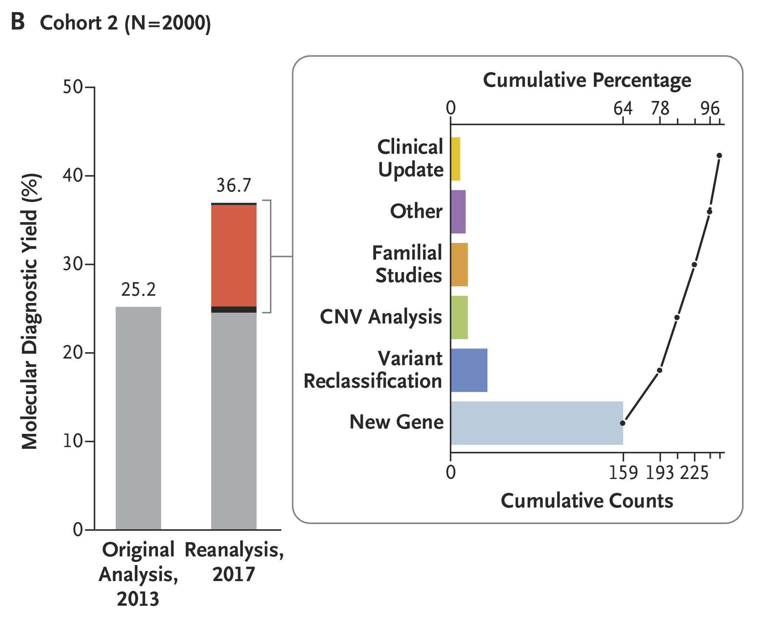
If at first you don’t succeed
DOI: 10.1056/NEJMc1812033

Slide 25
Why isn’t reanalysis of GS constant?

Slide 26
Diagnosis is nice Treatment is better Cures are best

Slide 27
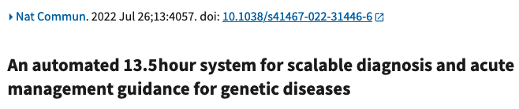
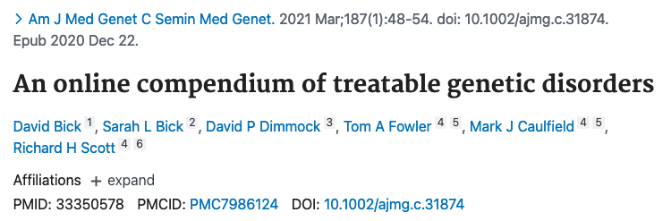
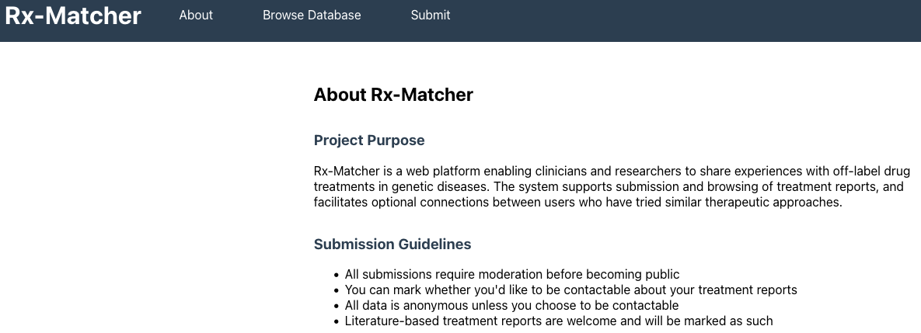


Slide 28
Is there a Drug for that?
We literally google gene symbols and “treatment”
We email colleagues and just ask them if they’ve ever treated a disease
We need to move faster

Slide 29
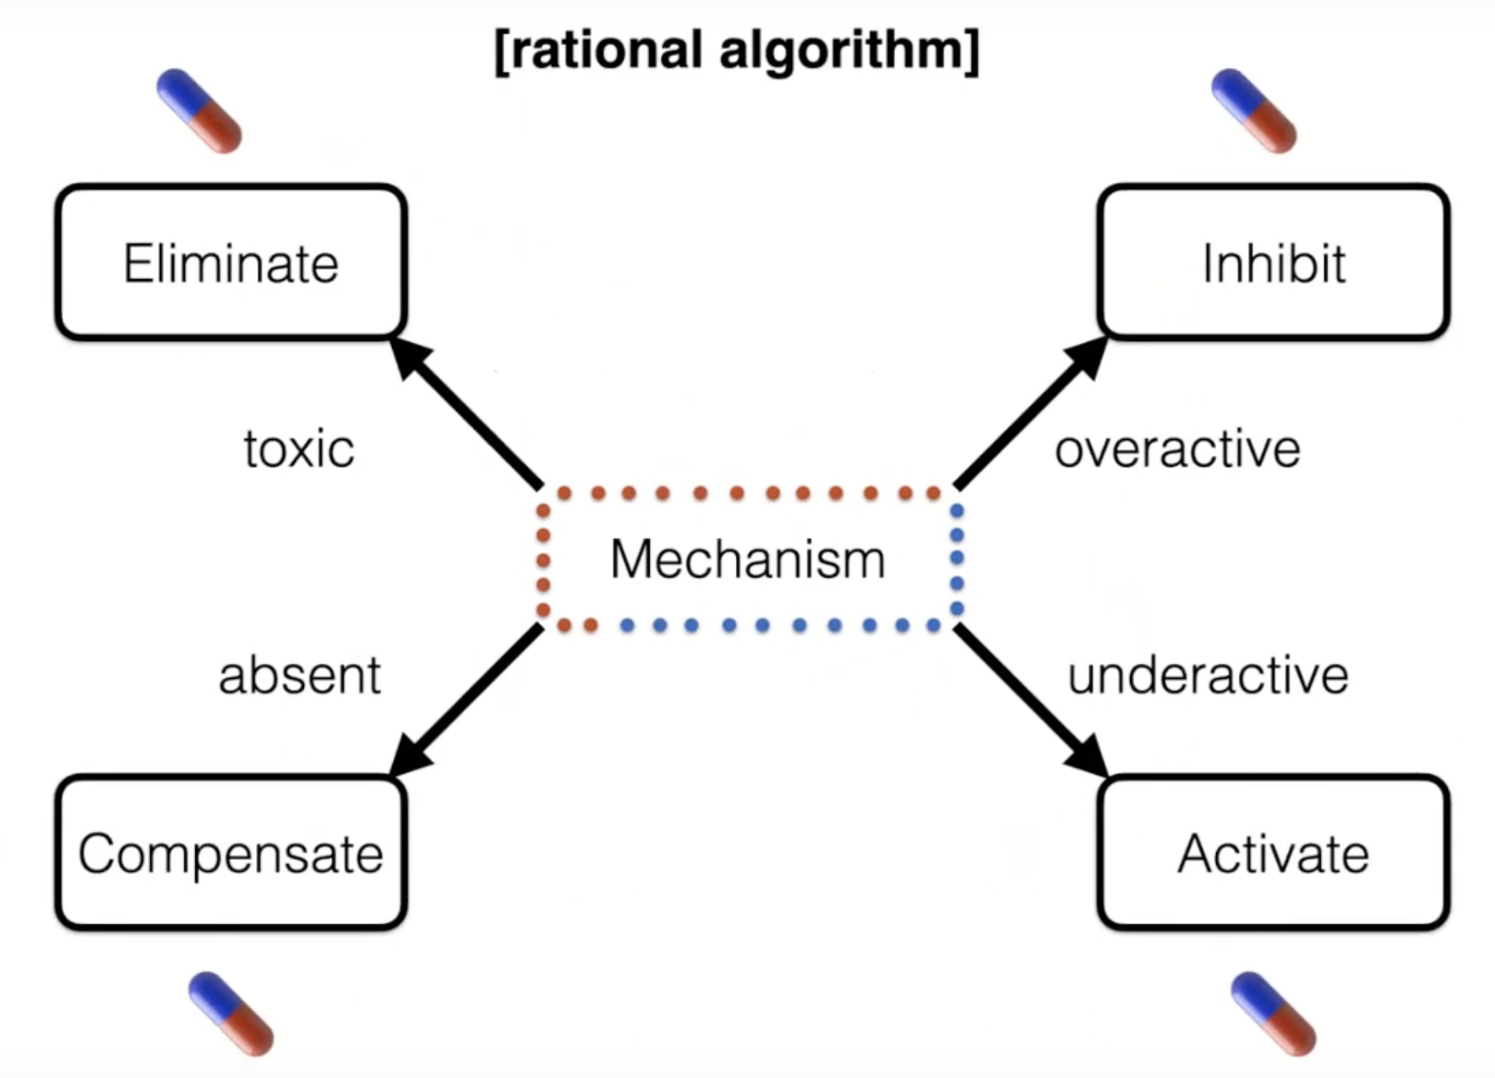
Matt Might

Slide 30

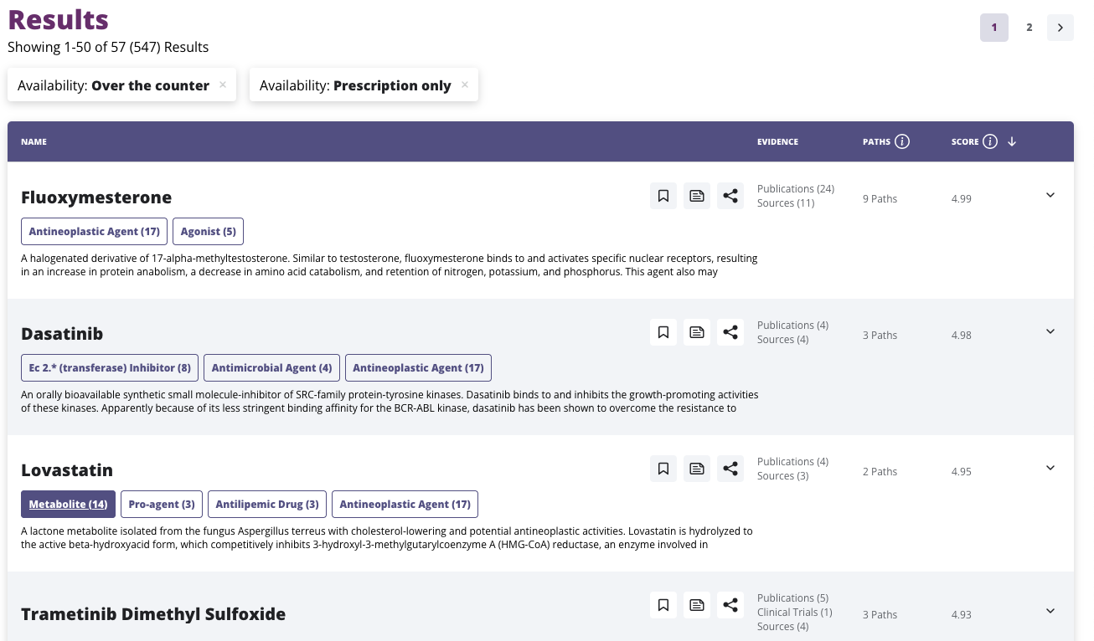
Notes:
Projects like the NCATS biotranslator allow you to start to do this, but it is still on you and your team to run down the leads it provides. As an example, here I asked it about drugs for a patient with noonan Syndrome and you can see it recapitulates the now well known use of trametinib in RASopathies.
The non-[rofit EveryCure recently for ~$50million from ARPA-H to build off of this, so stay tuned to this space for better tools and candidates emerging.

Slide 31
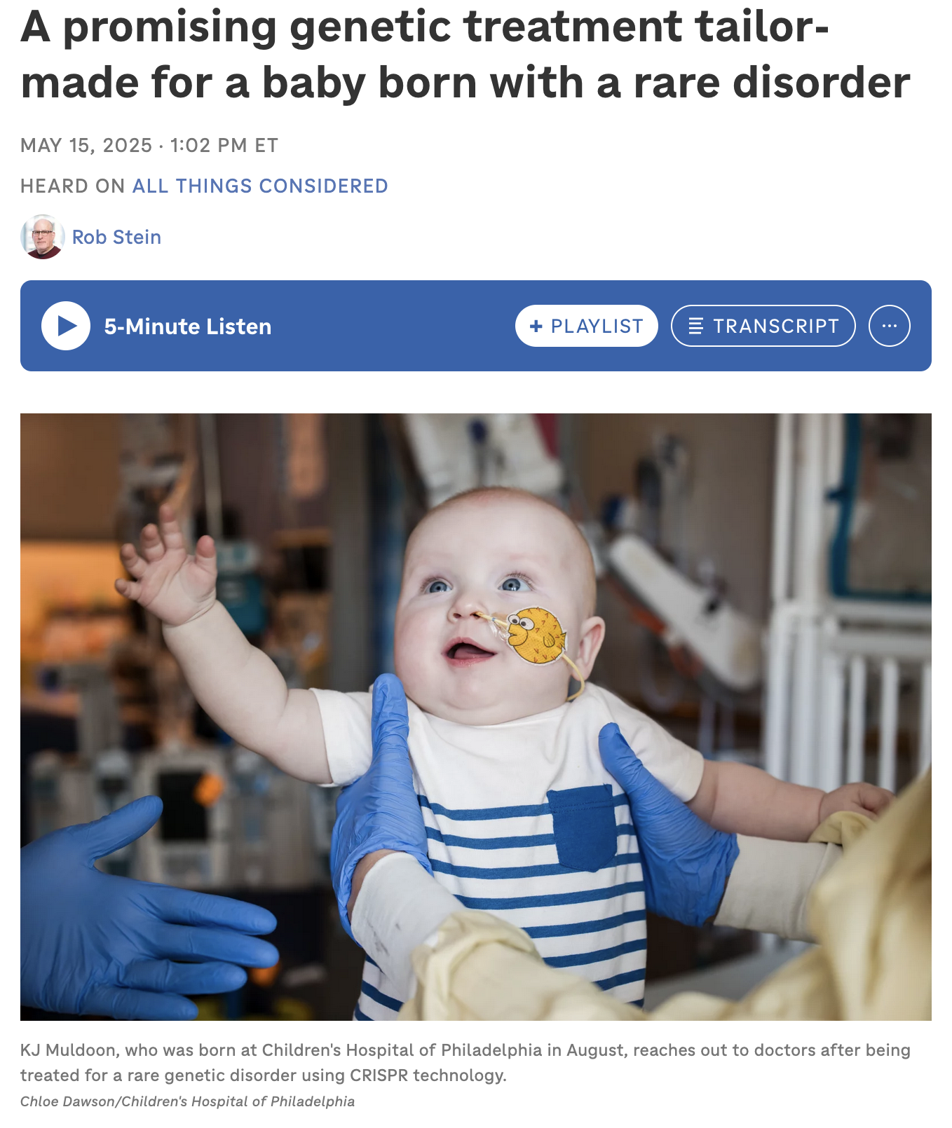
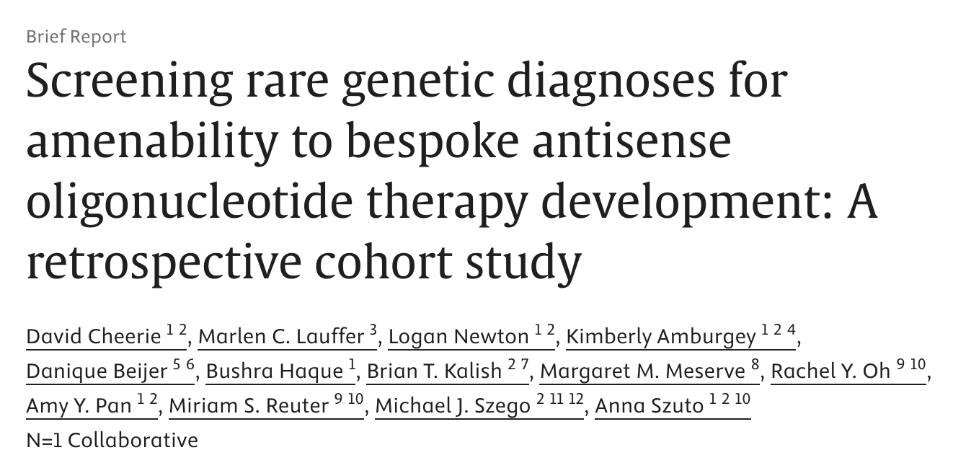
~2% variants ASO-able
Most patients dx after 1yo

Slide 32
Data is Life
Sequence sooner
Sequence faster
Automate as much as you can
Systematically map variants to treatments
YOU can save a life

Slide 33
Boy Who Stopped Eating
1 week old admitted because he stopped eating
Seizures
Seizures wouldn’t stop
rGS -> PDE
Treated, stopped seizing
Biggest problem is picking a preschool

Slide 34
Mom Knew; No One Listened
Born in NJ
Cardiac arrest after birth
Told it was HIE/“bad luck”
Moved to OH and kept telling anyone who would listen that it was NOT HIE
ES diagnosed with MoCD-A (FDA approved tx)

Slide 35
Boy Who Lived (Better)
2nd Pregnancy, also affected
Unable to treat in utero
Brought drug to delivery room
Still affected, but MUCH less than older brother

Slide 36
My Pet Peeve/Ask
Sequencing is insufficient
Variant interpretation is insufficient
Clinicians need impact (GoF? LoF? Dominant Negative)? and predicted therapeutic options
YOU can saves lives

Slide 37

Questions or Stories?
Thanks to
IGM
Peter White/ODS
Austin Antoniou
Regan McGinley
NCATS & NICHD

Slide 38
‘not’ seizures
Presented at 8 days with apneic episodes
Initially, low concern for seizures
Met neurology in hallway who said seizures
EEG confirmed
rGS for neonatal seizures

Slide 39
Other History
1 event prior– BRUE and sent home
No significant pre- or perinatal history
No significant family history

Slide 40
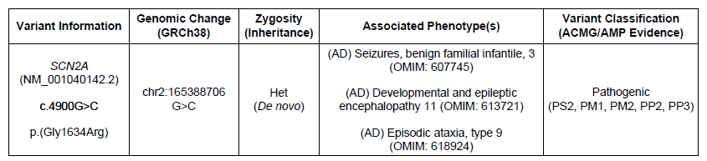
Genome
DEE mainly related to gain of function
Lab suspected
Clinically consistent
Need functional study in Australia to confirm

Slide 41
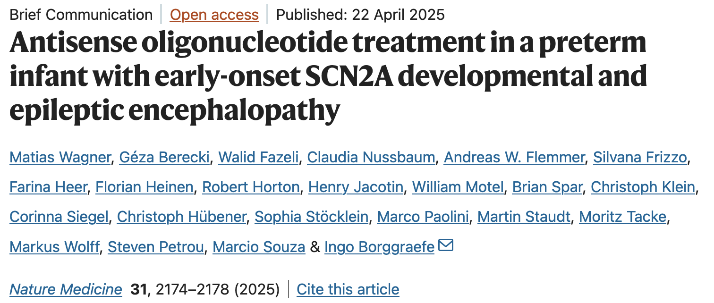
Bad News?
Dr. Burns: essentially untreatable DEE, then …

Slide 42
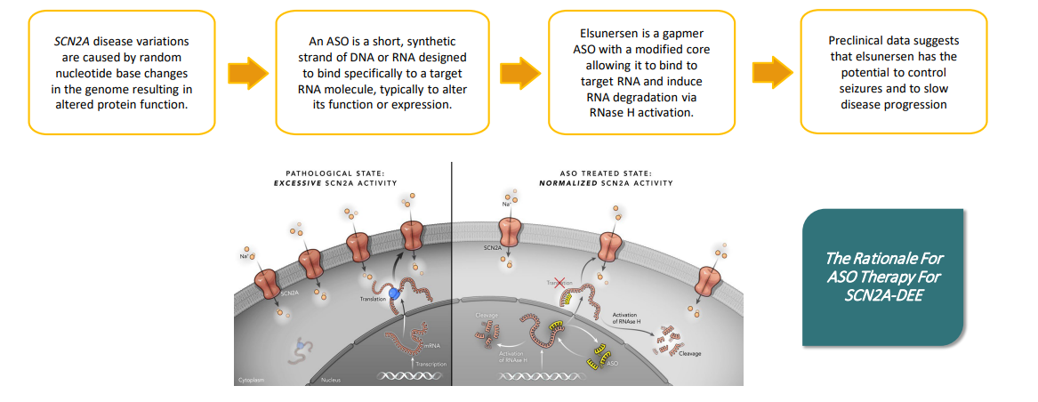
Elsunersen

Slide 43
Emergency IND
Proceeded with eIND after discussion with family, neurology and Praxis
Monthly IT injections
Some DD, sig. reduced sz burden

